Slide 1
Recommendation System
Zining Wang, Jiayu Yao, Qiyang Li

Slide 2
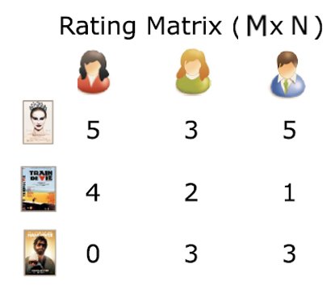
Recommendation System
Dataset:
User, Movie → Rating(1-5)
1 M dataset by Grouplens
User id, movie id, ratings
Additional user, movie information
Methods:
K Nearest Neighbor (KNN)
Singular Vector Decomposition (SVD)
Random Forest
Hybrid Recommendation System Methodology
Novel ideas..
?
Zining Wang, Jiayu Yao, Qiyang Li

Slide 4
Baseline: Global Mean Qiyang Li
KNN:
Just use global mean to guess...
test RMSE = 1.12
Zining Wang, Jiayu Yao, Qiyang Li

Slide 5
Baseline: KNN Jiayu Yao
KNN:
k = 100
test RMSE = 1.1177
Zining Wang, Jiayu Yao, Qiyang Li

Slide 6
Baseline: SVD
SVD:
k = numbers of eigen values we take
test RMSE = 0.9626
Zining Wang, Jiayu Yao, Qiyang Li

